Slide 1

Asymmetric/ Public Key Cryptography
Hashes
Notes:
This chapter begins with a discussion of the wide variety of applications for
cryptographic hash functions. Next, we look at the security requirements for such
functions. Then we look at the use of cipher block chaining to implement a cryptographic
hash function. The remainder of the chapter is devoted to the most important
and widely used family of cryptographic hash functions, the Secure Hash Algorithm
(SHA) family.

Slide 2
Services Provided by Cryptography
Data Confidentiality: Direct Symmetric or Asymmetric Cryptography
Data (Message) integrity
the assurance that data (message) has not been altered in an unauthorised (or accidental) manner since the time that the data(message) was last created, transmitted or stored by an authorised user.
Data origin authentication (Message Authentication)
the assurance that a given entity was the original source of some data (sometimes referred to as message authentication).
Entity authentication
the assurance that a given entity is involved and currently active in a communication session (sometimes referred to as identification).
Non-repudiation
the assurance that an entity cannot deny any previous commitments or actions (normally with respect to origin of data).
Before Studying these services, we will study Cryptographic Hash functions and Digital Signatures

Slide 3
Cryptographic Hash Functions
A hash function is a function that takes a relatively arbitrary amount of input and produces an output of fixed size.
The properties of some hash functions can be used to greatly increase the security of a system administrator’s network
when implemented correctly they can verify the integrity and source of a file, network packet, or any arbitrary data.
There are several hash functions currently in use today, including MD and SHA series.
By examining the history and security available in each function, the user can determine which algorithm is best suited for their application.
Notes:
OpenSSL

Slide 4
Cryptographic Hash Functions: Usage
Data integrity is a crucial part of any secure system. By using the message digests generated by a cryptographic hash function a system administrator can detect unauthorized changes in files.
This is especially important when safeguarding critical system binaries and sensitive databases.
A system administrator can use different tools that can be used for data verification.
Almost all tools are based on cryptographic hash functions and include Tripwire, md5sum and sha1sum.
When used by a knowledgeable system administrator, these tools are invaluable in verifying that a malicious user did not tamper with important system files.
Notes:
Digital Signatures and MAC

Slide 5
Other Hash Function Uses
Commonly used to create a one-way password file
When a user enters a password, the hash of that password is compared to the stored hash value for verification
This approach to password protection is used by most operating systems
Can be used for intrusion and virus detection
Store H(F) for each file on a system and secure the hash values
One can later determine if a file has been modified by recomputing H(F)
An intruder would need to change F without changing H(F)
Can be used to construct a pseudorandom function (PRF) or a pseudorandom number generator (PRNG)
A common application for a hash-based PRF is for the generation of symmetric keys
Notes:
Hash functions are commonly used to create a one-way password file . Chapter 21
explains a scheme in which a hash of a password is stored by an operating system
rather than the password itself. Thus, the actual password is not retrievable by
a hacker who gains access to the password file. In simple terms, when a user enters
a password, the hash of that password is compared to the stored hash value
for verification. This approach to password protection is used by most operating
systems.
Hash functions can be used for intrusion detection and virus detection . Store
H(F) for each file on a system and secure the hash values (e.g., on a CD-R that is
kept secure). One can later determine if a file has been modified by recomputing
H(F). An intruder would need to change F without changing H(F).
A cryptographic hash function can be used to construct a pseudorandom
function (PRF) or a pseudorandom number generator (PRNG) . A common application
for a hash-based PRF is for the generation of symmetric keys. We discuss this
application in Chapter 12.

Slide 6
Hash Functions: Basics
Hash functions are mathematical computations that take in a relatively arbitrary amount of data as input and produce an output of fixed size.
The output is always the same when given the same input.
The inputs to a hash function are typically called messages, and the outputs are often referred to as message digests, digest or hash
Nearly any piece of data can be defined as a message, including character strings, binary files and TCP packets.
An example of a simple hash function would be the following:
Hash function H accepts messages of any length, and outputs a fixed length digest of one-bit. H returns 0 as the message digest if the input has an even number of characters, and returns 1 if the output has an odd number of characters.

Slide 7
Hash Functions: Basics
All hash functions have the property that it is impossible to determine the input knowing only the output.
In our example function, knowing that the output is 1 does not reveal any information about the input other than it has an odd number of digits.
This property makes this hash functions a oneway function, meaning that it is difficult, if not impossible to deduce the input for a given output.
There are some hash functions which are much more powerful than the example given above; they are known as Cryptographic hash functions.
Cryptographic hash functions have another property that most hash functions do not; the property that it is very difficult to find two different messages that produce the same message digest.

Slide 8
Cryptographic Hash Functions: Basics
Two distinct messages that result in the same digest are called collisions.
In our example function, it is simple to create collisions.
Since different messages almost always produce different digests, one can conclude that if a message digest of a file changes, then the file itself has changed.
This property can be used to provide data integrity and data authentication to a system administrator.
SHA 2 series is the most commonly used.
named after their digest lengths (in bits): SHA-224, SHA-256, SHA-384, and SHA-512.
A new hash standard, SHA-3, is currently under development

Slide 9
Cryptographic Hash Functions: Data Integrity
Since two distinct messages are extremely unlikely to generate identical message digests, one can use this property of cryptographic hash functions to detect when a message has been altered.
If one takes a binary file and computes a digest of the file, one can record this baseline digest.
In the future, the digest can be recomputed on the file. If the new digest differs from the original baseline digest, then one can be assured that the file has been altered in some way
The only way that one could compute the digest of an altered file and have the digests match would be if one found a collision.
Since collisions are extremely unlikely to occur, if the new digest matches the original digest, it is extremely likely that the file has not been altered.

Slide 10
Cryptographic Hash Functions: Data Integrity
Notice though that one cannot determine specifically what contents of the message have changed, only that something in the message has changed.
Note that using message digests to verify data integrity is not possible if an attacker is able to modify the place at which the digests are stored.
An attacker could simply make an unauthorized change, compute the new digest for the file, and modify the digest database to include the new digest.
A system administrator would not know the difference (unless a digest of the database itself was stored in an independent location unavailable to the attacker).
One should always at a minimum password protect their digest database, or risk having their digests corrupted by a malicious user.

Slide 11
Cryptographic Hash Functions: Data Authentication
Another application of cryptographic hash functions is data authentication.
With data authentication, one can distinguish messages originating from the intended sender and an attacker.
Hash functions alone, unfortunately, cannot provide data authentication. Since the hashing functions are freely available, it is trivial to anyone, including an attacker, to create a digest for an arbitrary message. If one is given both a message and a digest, one can verify the integrity of the message.
However, it does not necessarily mean that it was the message sent by the original sender.
For example, if an email is sent with a message digest attached, the recipient could use the digest to verify the integrity of the message.

Slide 12
Cryptographic Hash Functions: Data Authentication
However, it is possible that an attacker modified both the message and the digest.
Suppose Customer A sends a message to their bank, asking them to transfer 5 dollars from their checking to their savings account.
Attacker A then blocks the transmission of Customer A’s message, and creates one of their own stating to transfer 500 dollars from Customer A’s checking account into Attacker A’s account.
Attacker A then computes the appropriate md5 checksum for the fraudulent message and sends it to the bank.
The bank could then verify that the data was not modified in transit, because the digest matches the message sent.
However, the message did not originate from Customer A, the only one who is authorized to make transactions from their checking account.
This is a very common attack called forgery. If the bank simply verified the message digest matches the message, it can never be assured that the sender was actually Customer A.

Slide 13
Data Authentication: Message Authentication Codes
In order to prevent forgery attacks, Message Authentication Codes were developed.
Message authentication codes are specially created message digests that can be created only by the original sender.
when two parties communicate they create a shared secret
key known only to themselves.
This shared key is used to encrypt data during the session.
There are several techniques used to create this shared key without exposing it to an attacker, such as the Diffie-Hellman key exchange protocol.

Slide 14
Data Authentication: Message Authentication Codes
One simple method would be to append(apply) the secret key to the message prior to performing the digest.
This digest becomes the message authentication code, and it is sent to the recipient.
In order to verify the source, the recipient would append (apply) the secret key to the received message and perform the digest.
If the digest is the same as the sent authentication code, then both the integrity and the source of the data has been verified;
Because only the sender and recipient know the secret key, it is not possible for an attacker to generate a successful message authentication code.

Slide 15
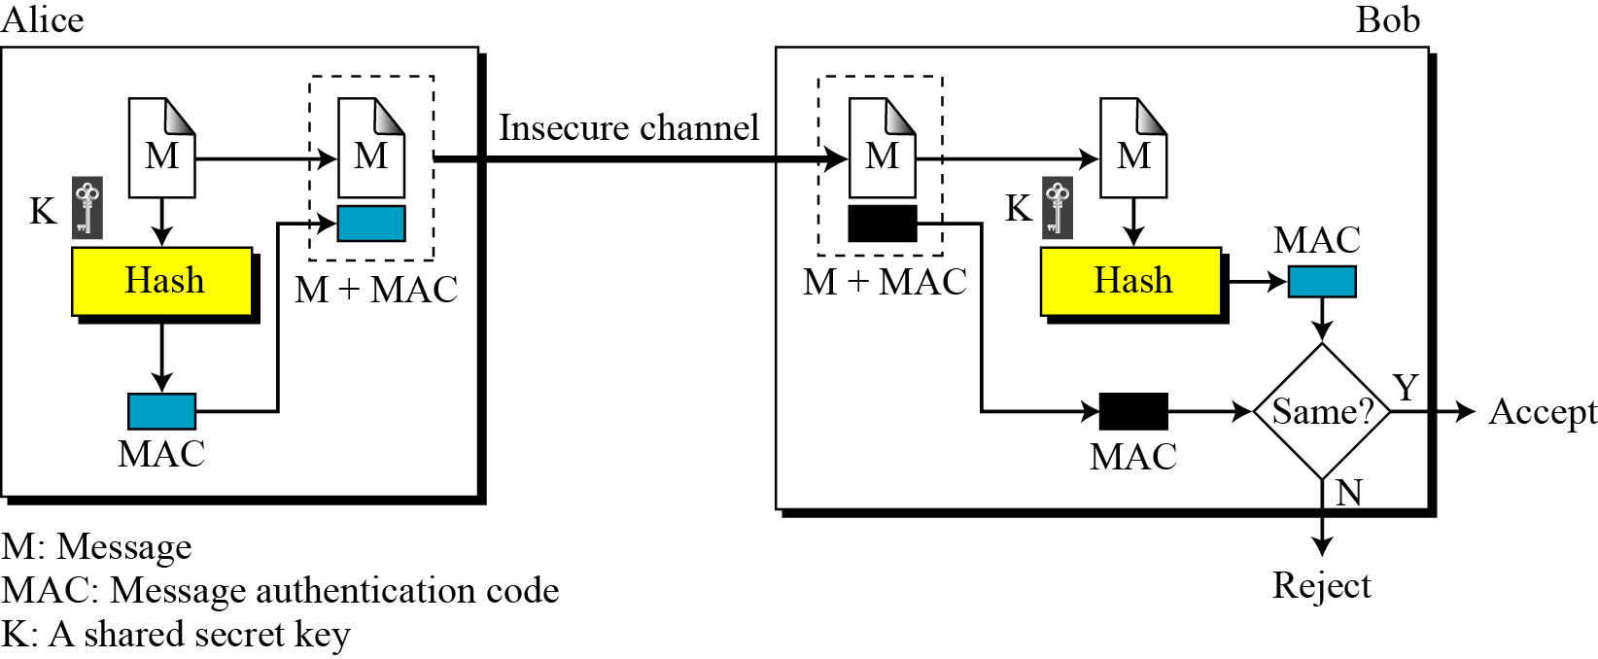
MAC
The security of a MAC depends on the security of the underlying hash algorithm.
Alice uses hash function to create a MAC from concatenation of key and message (Symmetric) and sends the message and MAC to Bob over insecure channel
Bob seperates the message from MAC and makes a new MAC from concatenation of message and the secret key
If match then the message is authentic

Slide 16
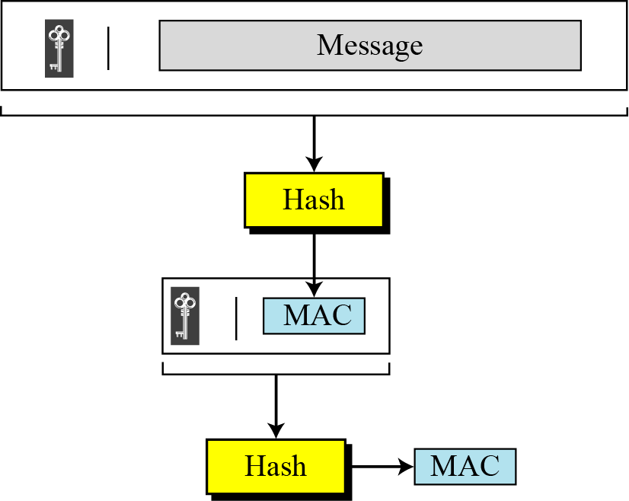
Nested MAC
Improves security of MAC, hashing is done in two steps - First key is concatenated with the message and hashed to create intermediate digest
- Second, the key is concatenated with the intermediate digest to create the final digest

Slide 17
HMAC
NIST standard for nested MAC
The message is divided into N blocks, each of b bits
Secret key is left padded with 0s to create a b-bit key (secret key before padding should be longer than n bits that is the size of HMAC: recommended) e.g. if b is 512 bits and key size is 128 bits we need to append 384 0s.
Result of 2nd step is exclusive-ored with a constant called ipad (input pad) to create a b-bit block. The value of ipad is the repetition of 00110110
The resulting block is prepended to N-block message. Now we have N+1 blocks
Result of Step 4 is hashed to create an n-bit digest to create intermediate HMAC

Slide 18
HMAC
6. Intermediate n-bit HMAC is left padded with 0s to make b-bit block
7. Steps 2 and 3 are repeated by different constant opad which is the repetition of sequence 01011100(5C in hexadecimal)
Result of Step 7 is prepended to the block of step 6
Result of Step 8 is hashed with the same hashing algorithm to create the final n-bit HMAC

Slide 19
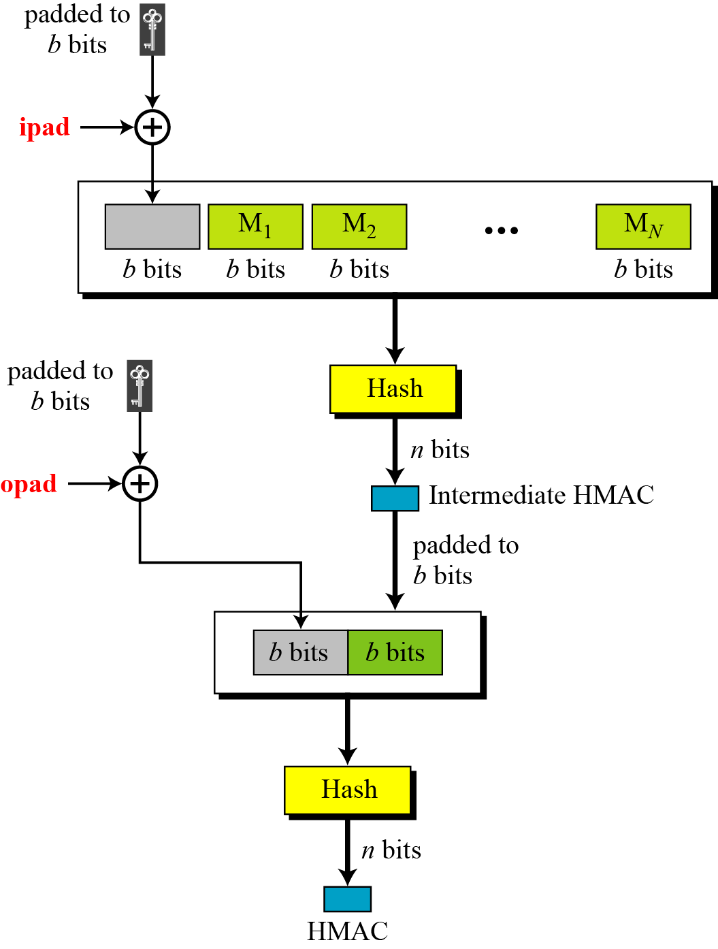
HMAC

Slide 20
Data Authentication: Replay Attacks
An attacker may not be able to successfully create a message authentication code for a new message.
However, an attacker has likely viewed previously valid message authentication codes in transit. Imagine this scenario:
Attacker A is an Internet merchant selling books on cryptography.
Whenever a purchase is made, he watches the messages that are sent to the bank to authorize the bank to transfer money from the customer’s account into his own.
The attacker has now seen a valid message (transfer money from his account to my account) and the associated authentication code.
The attacker can then send this message, along with its valid authentication code repeatedly, eventually transferring the customer’s entire account into his own.
HMAC prevents this type of attack by appending a form of timestamp to each message.
The recipient can then verify that the message has not been previously received.
The new timestamp will differentiate the messages.

Slide 21
How SHA 1 works
SHA-1 is the most widely used of the existing SHA hash functions and is employed in several widely used security applications and protocols.
In 2005, security flaws were identified in SHA-1, namely that a mathematical weakness might exist, indicating that a stronger hash function would be desirable.
Although no successful attacks have yet been reported on the SHA-2 variants, they are algorithmically similar to SHA-1.
Thus if we can get hold of SHA-1, we can get hold of SHA-2 series as well as algorithms are quite similar.
Efforts are underway to develop improved alternatives. A new hash standard, SHA-3, is currently under development.

Slide 22
How SHA 1 works
The SHA-1 algorithm accepts as input a message with a maximum length of 2⁶⁴ – 1 bits and produces a 160-bit message digest as output.
The message is processed by the compression function in 512-bit block.
Each block is divided further into sixteen 32-bit words denoted by M_{t} for t = 0,1,2…..15.
The compression function consists of four rounds, each round is made up of a sequence of twenty steps.
A complete SHA-1 round consists of eighty steps where a block length of 512 bits is used together with a 160-bit chaining variable to finally produce a 160-bit hash value.
The processing works as described in the following steps:

Slide 23
How SHA 1 works: Algorithm
Initialize variables:
h0 = 67452301
h1 = EFCDAB89
h2 = 98BADCFE
h3 = 10325476
h4 = C3D2E1F0
Pre-processing:
1. append the bit '1' to the message
2. append 0 ≤ k < 512 bits '0', so that the resulting message length (in bits) is congruent to 448 (mod 512)
3. append length of message (before pre-processing), in bits, as 64-bit big-endian integer

Slide 24
How SHA 1 works: Algorithm
Process the message in successive 512-bit chunks:
break message into 512-bit chunks
for each chunk{
break chunk into sixteen 32-bit big-endian words w[i], 0 ≤ i ≤ 15
Extend the sixteen 32-bit words into eighty 32-bit words:
for i from 16 to 79 {
w[i] = (w[i-3] xor w[i-8] xor w[i-14] xor w[i-16]) leftrotate 1
Initialize hash value for this chunk:
a = h0, b = h1, c = h2, d = h3, e = h4
}

Slide 25
How SHA 1 works: Algorithm
Process the message in successive 512-bit chunks:
Main loop:
for i from 0 to 79
if (0 ≤ i ≤ 19) then
f = (b and c) or ((not b) and d)
and k = 0x5A827999
else if (20 ≤ i ≤ 39)
f = b xor c xor d
and k = (0x6ED9EBA1)
else if (40 ≤ i ≤ 59)
f = (b and c) or (b and d) or (c and d)
and k = 0x8F1BBCDC

Slide 26
How SHA 1 works: Algorithm
Process the message in successive 512-bit chunks:
Main loop:
else if (60 ≤ i ≤ 79)
f = b xor c xor d
and k = 0xCA62C1D6
temp = (a leftrotate 5) + f + e + k + w[i] and
e = d, d = c, c = b leftrotate 30, b = a, a = temp
Add this chunk's hash to result so far:
h0 = h0 + a, h1 = h1 + b, h2 = h2 + c, h3 = h3 + d, h4 = h4 + e.
}
Produce the final hash value (big-endian): digest = hash = h0 append h1 append h2 append h3 append h4

Slide 27
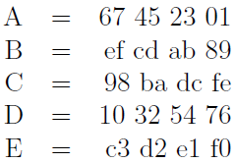
How SHA 1 works: Step 0
Initialize the Buffer:
The buffer consists of five (5) registers of 32 bits each denoted by A, B, C, D, and E.
This 160-bit buffer is used to hold temporary and final results of the compression function and are initialized as displayed

Slide 28
How SHA 1 works: Algorithm
Append padding bits:
The original message is padded so that its length is congruent to 448 modulo 512.
Again, padding is always added although the message already has the desired length. Padding consists of a single 1 followed by the necessary number of 0 bits.
Let the message be the ASCII binary-coded form of "abc", i.e., 01100001 01100010 01100011.
This message has length l = 24. In this step, we append a "1". Followed by 423 "0"s. to make a total length of 448.
So the message becomes
01100001 01100010 01100011 1(000000….0000): 423 zeros

Slide 29
How SHA 1 works: Step 2
Append Length:
A 64-bit block treated as an unsigned 64-bit integer, and representing the length of the original message (before padding in step 1), is appended to the message.
The entire message's length is now a multiple of 512.
So basically in the example we have to append (000..00011000: 64 bits).
The new message is 01100001 01100010 01100011 1000..000 000…00011000 where : Red: 423 zeros, Blue: 64 bit number
The padded message will contain 16 * n words for some n > 0.
The padded message is regarded as a sequence of n blocks M₁ , M₂, ... , M_{n}, where each M_{i} contains 16 words and M₁ contains the first characters (or bits) of the message. (Remember messages can be long)

Slide 30
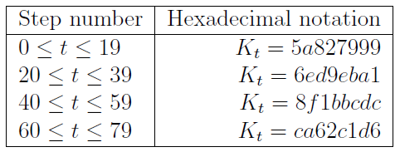
How SHA 1 works: Step 3
Process message in 512-bit blocks (Each Message is processed)
The compression function is divided into twenty sequential steps composed of four rounds
The four rounds are structurally similar to one another with the only difference that each round uses a different Boolean function, which we refer to as f₁; f₂; f₃; f₄ and one of four different additive constants K_{t} (0 <= t <= 79) which depends on the step under consideration.
The values of the four distinct additives constant are given below.

Slide 31
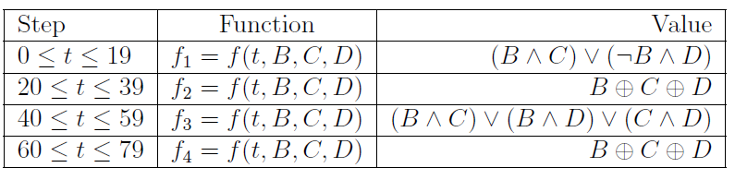
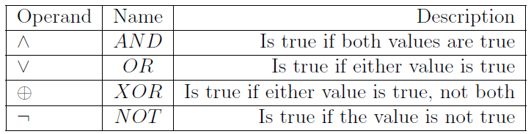
How SHA 1 works: Step 4
Process message in 512-bit blocks
The functions are
Where

Slide 32
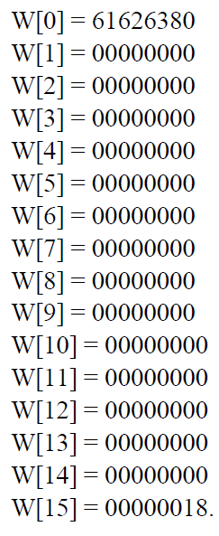
How SHA 1 works: Step 4
Process message
Now we can have a look at the algorithm and see how it is done.
Example is this (in Hexadecimal)
The initial hex values of {H_{i}} are H₀ = 67452301 H₁ = EFCDAB89 H₂ = 98BADCFE H₃ = 10325476 H₄ = C3D2E1F0.
Our message in Hexadecimal has
become (The first 16 W’s)

Slide 33
How SHA 1 works: Step 4
W[16]=W[13] XOR W[8] XOR W[2]XOR W[0]
And then leftrotate 1
We get 61626380 and then leftrotate by one
Before leftrotate
0110 0001 0110 0010 0110 0011 1000 0000
After leftrotate
1100 0010 1100 0100 1100 0111 0000 0000 i.e.
C 2 C 4 C 7 0 0 = W[16]
And so on until W[79]

Slide 34
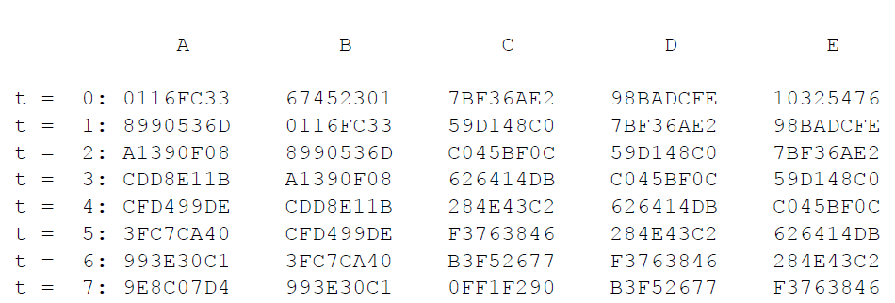
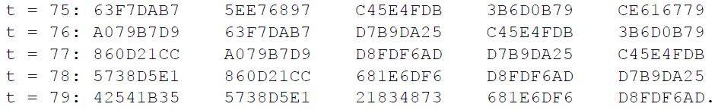
How SHA 1 works: Step 4
Process message

Slide 35
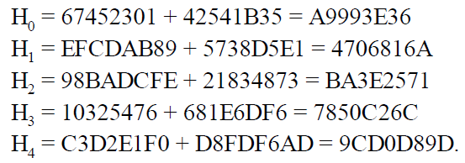
How SHA 1 works: Step 4
The block 1 has been processed now and we have got values
Addition is simple addition mod 2^32
And the Message digest is
What would have been scenrio if we had multiple blocks???

Slide 36
SHA-2 and 3
Consists of hash functions with digests
SHA-224, SHA-256, SHA-384, SHA-512, SHA-512/224. SHA-512/256
Significantly Different from SHA-1, Still people kept on using SHA-1
SHA-3, 2015 onwards
Message size is infinite
Available in SHA3-224, SHA3-256, SHA3-384,SHA3- 512

Slide 37
MD Series
The two most widely used hash function series are SHA and MD
MD5 is an improvement on MD4 before that we had MD2.
Widely used hash function producing a 128-bit hash value.
Has been found to suffer from extensive vulnerabilities.
It can still be used as a checksum to verify data integrity, but only against unintentional corruption.
A collision attack exists that can find collisions within seconds on a computer with a 2.6 GHz Pentium 4 processor
Susceptible to chosen-prefix collision attack that can produce a collision for two inputs with specified prefixes within hours
MD6 was sent in the competition for SHA-3 but later withdrawn

Slide 38
Review of Properties of Hash Functions
Four basic properties are typically desired of cryptographic hash functions.
The compression property requires that messages of any length be hashed to a fixed number of bits.
The pre-image resistance (a.k.a. one-way) property requires that it be hard to find a message that hashes to a particular value. (Attacker has hash wants to find the input)
The second preimage resistance (a.k.a. weak collision resistance) property requires that, given one message, it is hard to find a second message with the same hash as the first message. (Attacker has a message and its hash, wants to replace the original message with the hash in possession)
The collision resistance (a.k.a. strong collision resistance) property requires that it be hard to find any two messages with the same hash. (Attacker wants to find two values that hash to same value)

Slide 39
Requirements and Security
Preimage
Collision
x is the preimage of h for a hash value h = H(x)
Is a data block whose hash function, using the function H, is h
Because H is a many-to-one mapping, for any given hash value h, there will in general be multiple preimages
Occurs if we have x ≠ y and H(x) = H(y)
Because we are using hash functions for data integrity, collisions are clearly undesirable
Notes:
Before proceeding, we need to define two terms. For a hash value h = H(x ), we say
that x is the preimage of h . That is, x is a data block whose hash function, using the
function H, is h . Because H is a many-to-one mapping, for any given hash value h ,
there will in general be multiple preimages. A collision occurs if we have x ≠ y and
H(x ) = H(y ). Because we are using hash functions for data integrity, collisions are
clearly undesirable.

Slide 40
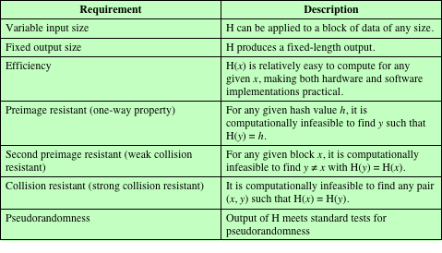
Table 11.1 Requirements for a Cryptographic Hash Function H
(Table can be found on page 323 in textbook.)
Notes:
Table 11.1 lists the generally accepted requirements for a cryptographic hash function.
The first three properties are requirements for the practical application of a
hash function.
The fourth property, preimage resistant , is the one-way property: it is easy
to generate a code given a message, but virtually impossible to generate a message
given a code. This property is important if the authentication technique involves the
use of a secret value (Figure 11.3c). The secret value itself is not sent.
The fifth property, second preimage resistant , guarantees that it is impossible
to find an alternative message with the same hash value as a given message. This
prevents forgery when an encrypted hash code is used (Figures 11.3b and 11.4a). If
this property were not true, an attacker would be capable of the following sequence:
First, observe or intercept a message plus its encrypted hash code; second, generate
an unencrypted hash code from the message; third, generate an alternate message
with the same hash code.
A hash function that satisfies the first five properties in Table 11.1 is referred
to as a weak hash function. If the sixth property, collision resistant , is also satisfied,
then it is referred to as a strong hash function. A strong hash function protects
against an attack in which one party generates a message for another party to sign.
For example, suppose Bob writes an IOU message, sends it to Alice, and she signs
it. Bob finds two messages with the same hash, one of which requires Alice to pay a
small amount and one that requires a large payment. Alice signs the first message,
and Bob is then able to claim that the second message is authentic
The final requirement in Table 11.1, pseudorandomness , has not traditionally
been listed as a requirement of cryptographic hash functions but is more or less implied.
[JOHN05] points out that cryptographic hash functions are commonly used
for key derivation and pseudorandom number generation, and that in message integrity
applications, the three resistant properties depend on the output of the hash
function appearing to be random. Thus, it makes sense to verify that in fact a given
hash function produces pseudorandom output..

Slide 41
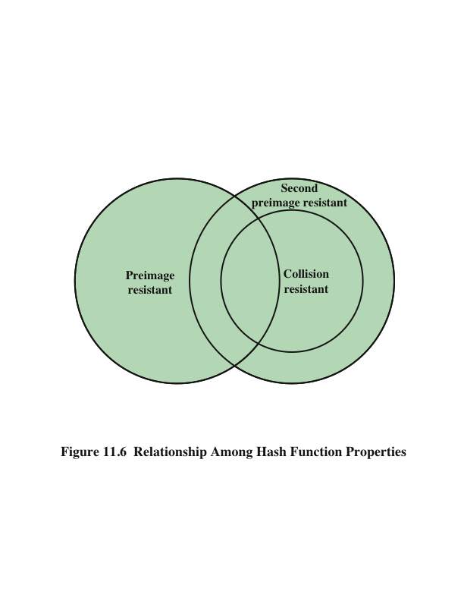
Notes:
Figure 11.6 shows the relationships among the three resistant properties.
A function that is collision resistant is also second preimage resistant, but the
reverse is not necessarily true. A function can be collision resistant but not preimage
resistant and vice versa. A function can be preimage resistant but not second
preimage resistant and vice versa. See [MENE97] for a discussion.

Slide 42
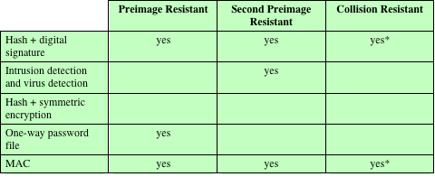
Table 11.2 Hash Function Resistance Properties Required for Various Data Integrity Applications
* Resistance required if attacker is able to mount a chosen message attack
Notes:
Table 11.2 shows the resistant properties required for various hash function
applications.

Slide 43
Attacks on Hash Functions
Brute-Force Attacks
Cryptanalysis
Does not depend on the specific algorithm, only depends on bit length
In the case of a hash function, attack depends only on the bit length of the hash value
Method is to pick values at random and try each one until a collision occurs
An attack based on weaknesses in a particular cryptographic algorithm
Seek to exploit some property of the algorithm to perform some attack other than an exhaustive search
Notes:
SHA 1 Shattered 1 because of cryptanalysis attack. Password database Brute force attack

Slide 44
Collision Resistant Attacks
For a collision resistant attack, an adversary wishes to find two messages or data blocks that yield the same hash function
The effort required is explained by a mathematical result referred to as the birthday paradox
Yuval proposed the following strategy to exploit the birthday paradox in a collision resistant attack:
The source (A) is prepared to sign a legitimate message x by appending the appropriate m-bit hash code and encrypting that hash code with A’s private key
Opponent generates 2^{m/2} variations x’ of x, all with essentially the same meaning, and stores the messages and their hash values
Opponent prepares a fraudulent message y for which A’s signature is desired
Opponent generates minor variations y’ of y, all of which convey essentially the same meaning. For each y’, the opponent computes H (y’), checks for matches with any of the H (x’) values, and continues until a match is found. That is, the process continues until a y’ is generated with a hash value equal to the hash value of one of the x’ values
The opponent offers the valid variation to A for signature which can then be attached to the fraudulent variation for transmission to the intended recipient
Because the two variations have the same hash code, they will produce the same signature and the opponent is assured of success even though the encryption key is not known
Notes:
For a collision resistant attack, an adversary wishes
to find two messages or data blocks, x and y , that yield the same hash function:
H(x) = H(y). This turns out to require considerably less effort than a preimage or
second preimage attack. The effort required is explained by a mathematical result
referred to as the birthday paradox. In essence, if we choose random variables from
a uniform distribution in the range 0 through N - 1, then the probability that a
repeated element is encountered exceeds 0.5 after √N choices have been made.
Thus, for an m-bit hash value, if we pick data blocks at random, we can expect to
find two data blocks with the same hash value within √2^{m} = 2^{m/2} attempts. The
mathematical derivation of this result is found in Appendix U.
Yuval proposed the following strategy to exploit the birthday paradox in a
Collision resistant attack [YUVA79].
The source, A, is prepared to sign a legitimate message x by appending the appropriate m-bit hash code and encrypting that hash code with A’s private key (Figure 11.4a).
2. The opponent generates 2^{m/2} variations x’ of x, all of which convey essentially
the same meaning, and stores the messages and their hash values.
3. The opponent prepares a fraudulent message y for which A’s signature is
desired.
4. The opponent generates minor variations y’ of y, all of which convey essentially
the same meaning. For each y’, the opponent computes H(y’), checks
for matches with any of the H(x’) values, and continues until a match is found.
That is, the process continues until a y’ is generated with a hash value equal to
the hash value of one of the x’ values.
5. The opponent offers the valid variation to A for signature. This signature can
then be attached to the fraudulent variation for transmission to the intended
recipient. Because the two variations have the same hash code, they will produce
the same signature; the opponent is assured of success even though the
encryption key is not known.
Thus, if a 64-bit hash code is used, the level of effort required is only on the
order of 2³² [see Appendix U, Equation (U.7)].
The generation of many variations that convey the same meaning is not difficult.
For example, the opponent could insert a number of “space-space-backspace”
character pairs between words throughout the document. Variations could then
be generated by substituting “space-backspace-space” in selected instances.
Alternatively, the opponent could simply reword the message but retain the
Meaning. Figure 11.7 provides an example.
To summarize, for a hash code of length m, the level of effort required, as we
have seen, is proportional to the following.
Preimage resistant 2^{m}
Second preimage resistant 2^{m}
Collision resistant 2^{m/2}

Slide 45
Hash Functions Based on Cipher Block Chaining
A number of proposals have been made for hash functions based on using a cipher block chaining technique, but without using the secret key
One of the first proposals was that of Rabin
Divide a message M into fixed-size blocks M₁, M₂, . . . , M_{N} and use a symmetric encryption system such as DES to compute the hash code G as
H₀= initial value
H_{i} = E(M_{i,} H_{i-1})
G = H_{N}
Similar to the CBC technique, but in this case, there is no secret key
As with any hash code, this scheme is subject to the birthday attack
If the encryption algorithm is DES and only a 64-bit hash code is produced, the system is vulnerable
Meet-in-the-middle-attack
Another version of the birthday attack used even if the opponent has access to only one message and its valid signature and cannot obtain multiple signings
It can be shown that some form of birthday attack will succeed against any hash scheme involving the use of cipher block chaining without a secret key, provided that either the resulting hash code is small enough or that a larger hash code can be decomposed into independent subcodes
Notes:
A number of proposals have been made for hash functions based on using a cipher block chaining technique, but without the secret key (instead using the message blocks as keys). One of the first such proposals was that of Rabin, [RABI78]. Divide a message M into fixed-size blocks, and use a symmetric encryption system such as DES to compute the hash code G as shown. This is similar to the CBC technique, but in this case there is no secret key. As with any hash code, this scheme is subject to the birthday attack, and if the encryption algorithm is DES and only a 64-bit hash code is produced, then the system is vulnerable.
Furthermore, another version of the birthday attack can be used even if the opponent has access to only one message and its valid signature and cannot obtain multiple signings.
It can be shown that some form of birthday attack will succeed against any hash scheme involving the use of cipher block chaining without a secret key, provided that either the resulting hash code is small enough
(e.g., 64 bits or less) or that a larger hash code can be decomposed into independent subcodes [JUEN87].
Thus, attention has been directed at finding other approaches to hashing.
Many of these have also been shown to have weaknesses [MITC92].

Slide 46
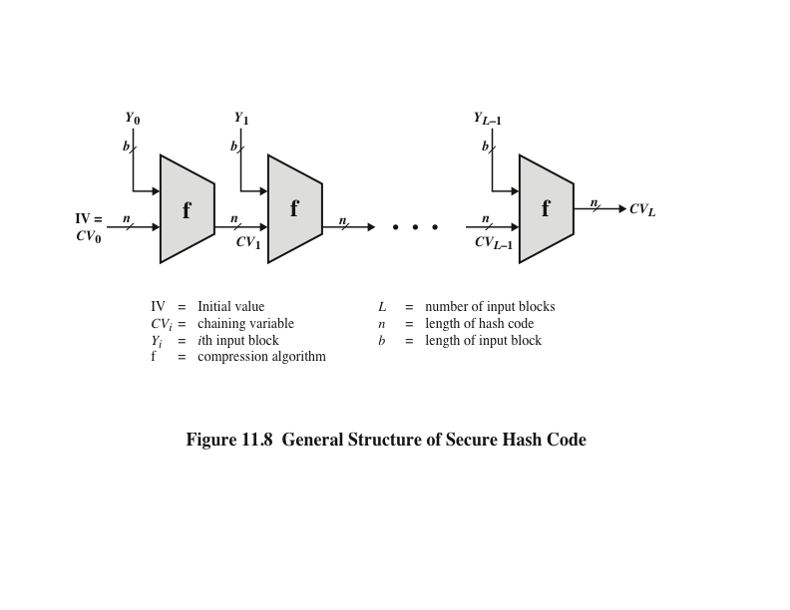
Notes:
In recent years, there has been considerable effort, and some successes,
in developing cryptanalytic attacks on hash functions. To understand these, we
need to look at the overall structure of a typical secure hash function, indicated in
Figure 11.8. This structure, referred to as an iterated hash function, was proposed
by Merkle [MERK79, MERK89] and is the structure of most hash functions in use
today, including SHA, which is discussed later in this chapter. The hash function
takes an input message and partitions it into L fixed-sized blocks of b bits each.
If necessary, the final block is padded to b bits. The final block also includes the
value of the total length of the input to the hash function. The inclusion of the
length makes the job of the opponent more difficult. Either the opponent must
find two messages of equal length that hash to the same value or two messages of
differing lengths that, together with their length values, hash to the same value.
The hash algorithm involves repeated use of a compression function, f, that
takes two inputs (an n-bit input from the previous step, called the chaining variable ,
and a b -bit block) and produces an n -bit output. At the start of hashing, the chaining
variable has an initial value that is specified as part of the algorithm. The final
value of the chaining variable is the hash value.

Slide 47
Secure Hash Algorithm (SHA)
SHA was originally designed by the National Institute of Standards and Technology (NIST) and published as a federal information processing standard (FIPS 180) in 1993
Was revised in 1995 as SHA-1
Based on the hash function MD4 and its design closely models MD4
Produces 160-bit hash values
In 2002 NIST produced a revised version of the standard that defined three new versions of SHA with hash value lengths of 256, 384, and 512
Collectively known as SHA-2
Notes:
In recent years, the most widely used hash function has been the Secure Hash
Algorithm (SHA). Indeed, because virtually every other widely used hash function
had been found to have substantial cryptanalytic weaknesses, SHA was more or
less the last remaining standardized hash algorithm by 2005. SHA was developed
by the National Institute of Standards and Technology (NIST) and published as a
federal information processing standard (FIPS 180) in 1993. When weaknesses were
discovered in SHA, now known as SHA-0, a revised version was issued as FIPS
180-1 in 1995 and is referred to as SHA-1. The actual standards document is entitled
“Secure Hash Standard.” SHA is based on the hash function MD4, and its design
closely models MD4.
SHA-1 produces a hash value of 160 bits. In 2002, NIST produced a revised
version of the standard, FIPS 180-2, that defined three new versions of SHA, with
hash value lengths of 256, 384, and 512 bits, known as SHA-256, SHA-384, and
SHA-512, respectively. Collectively, these hash algorithms are known as SHA-2 .
These new versions have the same underlying structure and use the same types of
modular arithmetic and logical binary operations as SHA-1.

Slide 48
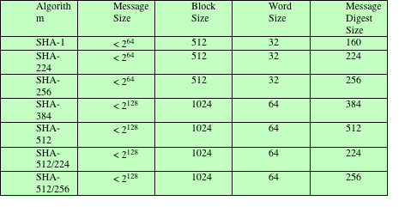
Table 11.3 Comparison of SHA Parameters
Note: All sizes are measured in bits.
Notes:
A revised document was issued as FIP PUB 180-3 in 2008, which added a 224-bit version (Table 11.3).
In 2015, NIST issued FIPS 180-4, which added two additional algorithms:
SHA-512/224 and SHA-512/256. SHA-1 and SHA-2 are also specified in RFC
6234, which essentially duplicates the material in FIPS 180-3 but adds a C code
implementation.
In 2005, NIST announced the intention to phase out approval of SHA-1
and move to a reliance on SHA-2 by 2010. Shortly thereafter, a research team described
an attack in which two separate messages could be found that deliver the
same SHA-1 hash using 2⁶⁹ operations, far fewer than the 2⁸⁰ operations previously
thought needed to find a collision with an SHA-1 hash [WANG05]. This result
should hasten the transition to SHA-2.

Slide 49
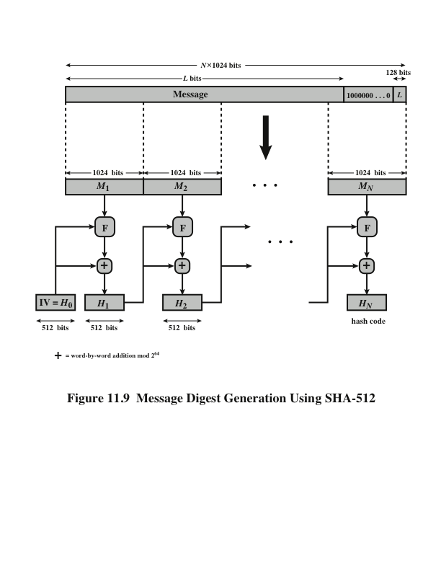
Notes:
The algorithm takes as input a message with a maximum length of less than 2¹²⁸ bits
and produces as output a 512-bit message digest. The input is processed in 1024-bit
blocks. Figure 11.9 depicts the overall processing of a message to produce a digest.
This follows the general structure depicted in Figure 11.8. The processing consists
of the following steps.
Step 1 Append padding bits. The message is padded so that its length is congruent
to 896 modulo 1024 [length = 896(mod 1024)]. Padding is always added,
even if the message is already of the desired length. Thus, the number of
padding bits is in the range of 1 to 1024. The padding consists of a single 1
bit followed by the necessary number of 0 bits.
Step 2 Append length. A block of 128 bits is appended to the message. This block
is treated as an unsigned 128-bit integer (most significant byte first) and
contains the length of the original message (before the padding).
The outcome of the first two steps yields a message that is an integer
multiple of 1024 bits in length. In Figure 11.9, the expanded message is
represented as the sequence of 1024-bit blocks M₁ , M₂ , . . . , M_{N} , so that the
total length of the expanded message is N * 1024 bits.
Step 3 Initialize hash buffer. A 512-bit buffer is used to hold intermediate
and final results of the hash function. The buffer can be represented as eight 64-bit
registers (a, b, c, d, e, f, g, h). These registers are initialized to the following
64-bit integers (hexadecimal values):
a = 6A09E667F3BCC908 e = 510E527FADE682D1
b = BB67AE8584CAA73B f = 9B05688C2B3E6C1F
c = 3C6EF372FE94F82B g = 1F83D9ABFB41BD6B
d = A54FF53A5F1D36F1 h = 5BE0CD19137E2179
These values are stored in big-endian format, which is the most significant
byte of a word in the low-address (leftmost) byte position. These words
were obtained by taking the first sixty-four bits of the fractional parts of the
square roots of the first eight prime numbers.
Step 4 Process message in 1024-bit (128-word) blocks. The heart of the algorithm
is a module that consists of 80 rounds; this module is labeled F in Figure 11.9.
The logic is illustrated in Figure 11.10.
Each round takes as input the 512-bit buffer value, abcdefgh, and
updates the contents of the buffer. At input to the first round, the buffer
has the value of the intermediate hash value, H_{i-1} . Each round t makes
use of a 64-bit value W_{t}, derived from the current 1024-bit block being processed
(M_{i} ). These values are derived using a message schedule described
subsequently. Each round also makes use of an additive constant K_{t} , where
0 ≤ t ≤ 79 indicates one of the 80 rounds. These words represent the first
64 bits of the fractional parts of the cube roots of the first 80 prime numbers.
Step 5 Output. After all N 1024-bit blocks have been processed, the output from
the Nth stage is the 512-bit message digest.

Slide 50
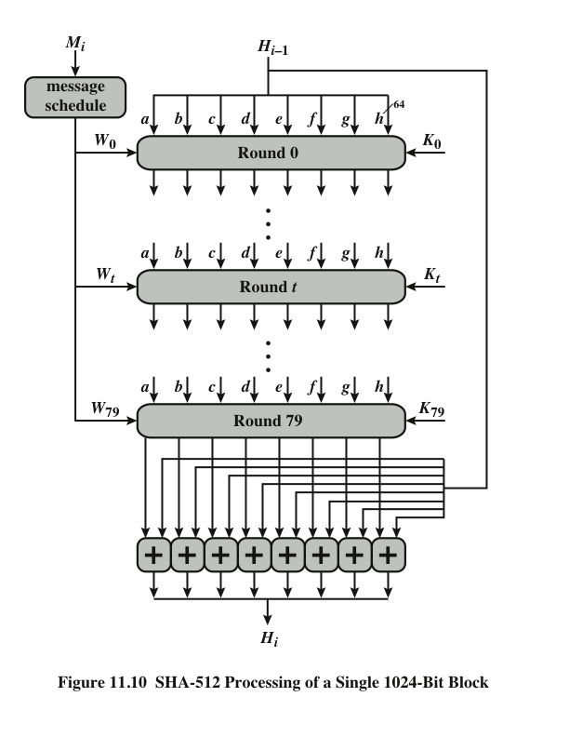
Notes:
The heart of the algorithm is a module that consists of 80 rounds; this module is labeled F in Figure 11.9.
The logic is illustrated in Figure 11.10.
Each round takes as input the 512-bit buffer value, abcdefgh, and
updates the contents of the buffer. At input to the first round, the buffer
has the value of the intermediate hash value, H_{i-1} . Each round t makes
use of a 64-bit value W_{t}, derived from the current 1024-bit block being processed
(M_{i} ). These values are derived using a message schedule described
subsequently. Each round also makes use of an additive constant K_{t} , where
0 ≤ t ≤ 79 indicates one of the 80 rounds. These words represent the first
64 bits of the fractional parts of the cube roots of the first 80 prime numbers.

Slide 51
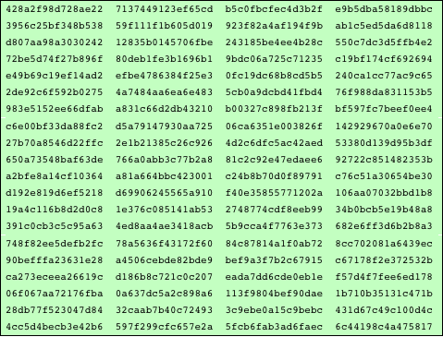
Table 11.4 ---- SHA-512 Constants
(Table can be found on page 341 in textbook)
Notes:
The constants provide a “randomized” set of 64-bit patterns, which should
eliminate any regularities in the input data. Table 11.4 shows these constants
in hexadecimal format (from left to right).

Slide 52
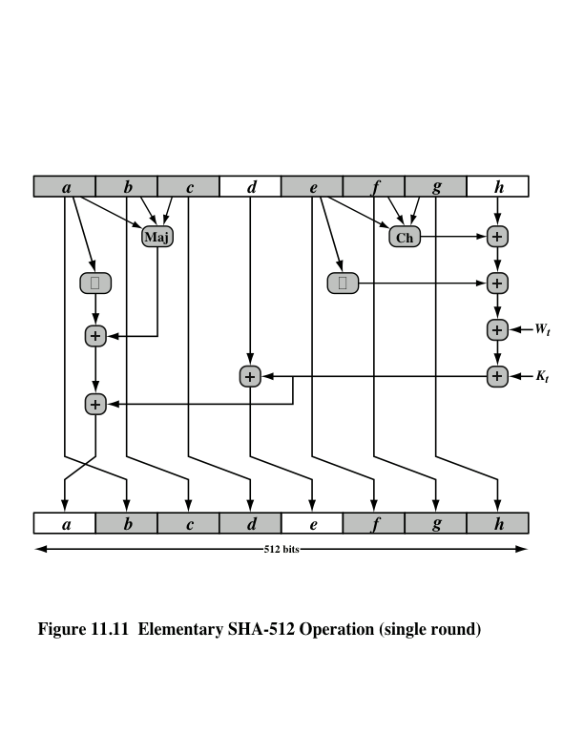
Notes:
Let us look in more detail at the logic in each of the 80 steps of the processing
of one 512-bit block (Figure 11.11).

Slide 53
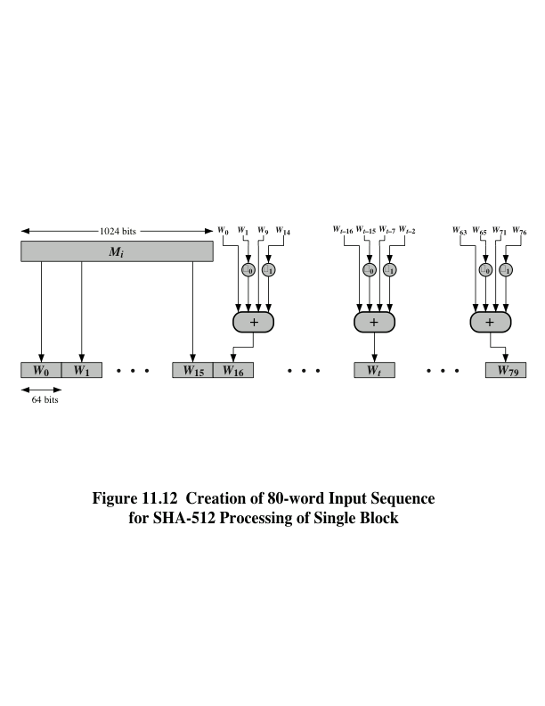
Notes:
Figure 11.12 Creation of 80-word Input Sequence for SHA-512 Processing of Single Block

Slide 54
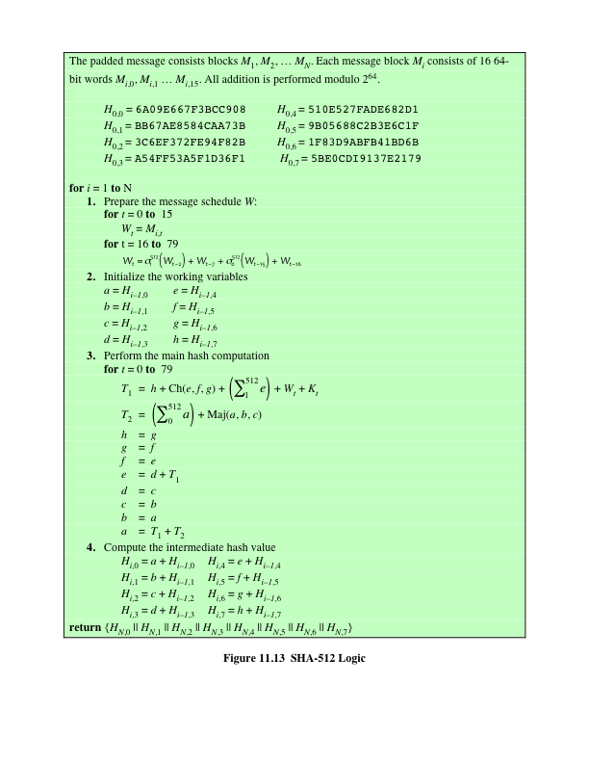
(Figure can be found on page 345 in textbook)
Notes:
Figure 11.13 summarizes the SHA-512 logic.
The SHA-512 algorithm has the property that every bit of the hash code is a
function of every bit of the input. The complex repetition of the basic function F
produces results that are well mixed; that is, it is unlikely that two messages chosen
at random, even if they exhibit similar regularities, will have the same hash code.
Unless there is some hidden weakness in SHA-512, which has not so far been published,
the difficulty of coming up with two messages having the same message digest
is on the order of 2²⁵⁶ operations, while the difficulty of finding a message with
a given digest is on the order of 2⁵¹² operations.

Slide 55
SHA-3
SHA-1 has not yet been "broken”
No one has demonstrated a technique for producing collisions in a practical amount of time
Considered to be insecure and has been phased out for SHA-2
SHA-2 shares the same structure and mathematical operations as its predecessors so this is a cause for concern
Because it will take years to find a suitable replacement for SHA-2 should it become vulnerable, NIST decided to begin the process of developing a new hash standard
NIST announced in 2007 a competition for the SHA-3 next generation NIST hash function
Winning design was announced by NIST in October 2012
SHA-3 is a cryptographic hash function that is intended to complement SHA-2 as the approved standard for a wide range of applications
Notes:
As of this writing, the Secure Hash Algorithm (SHA-1) has not yet been “broken.”
That is, no one has demonstrated a technique for producing collisions in a practical
amount of time. However, because SHA-1 is very similar, in structure and in the
basic mathematical operations used, to MD5 and SHA-0, both of which have been
broken, SHA-1 is considered insecure and has been phased out for SHA-2.
SHA-2, particularly the 512-bit version, would appear to provide unassailable
security. However, SHA-2 shares the same structure and mathematical operations
as its predecessors, and this is a cause for concern. Because it will take years to find
a suitable replacement for SHA-2, should it become vulnerable, NIST decided to
begin the process of developing a new hash standard.
Accordingly, NIST announced in 2007 a competition to produce the next generation
NIST hash function, to be called SHA-3. The winning design for SHA-3
was announced by NIST in October 2012. SHA-3 is a cryptographic hash function
that is intended to complement SHA-2 as the approved standard for a wide range
of applications.
Appendix V looks at the evaluation criteria used by NIST to select from
among the candidates for AES, plus the rationale for picking Keccak, which was
the winning candidate. This material is useful in understanding not just the SHA-3
design but also the criteria by which to judge any cryptographic hash algorithm.

Slide 56
The Sponge Construction
Underlying structure of SHA-3 is a scheme referred to by its designers as a sponge construction
Takes an input message and partitions it into fixed-size blocks
Each block is processed in turn with the output of each iteration fed into the next iteration, finally producing an output block
The sponge function is defined by three parameters:
f = the internal function used to process each input block
r = the size in bits of the input blocks, called the bitrate
pad = the padding algorithm
Notes:
The underlying structure of SHA-3 is a scheme referred to by its designers as a
sponge construction [BERT07, BERT11]. The sponge construction has the same
general structure as other iterated hash functions (Figure 11.8). The sponge function
takes an input message and partitions it into fixed-size blocks. Each block is
processed in turn with the output of each iteration fed into the next iteration, finally
producing an output block.
The sponge function is defined by three parameters:
f = the internal function used to process each input block
r = the size in bits of the input blocks, called the bitrate
pad = the padding algorithm

Slide 57
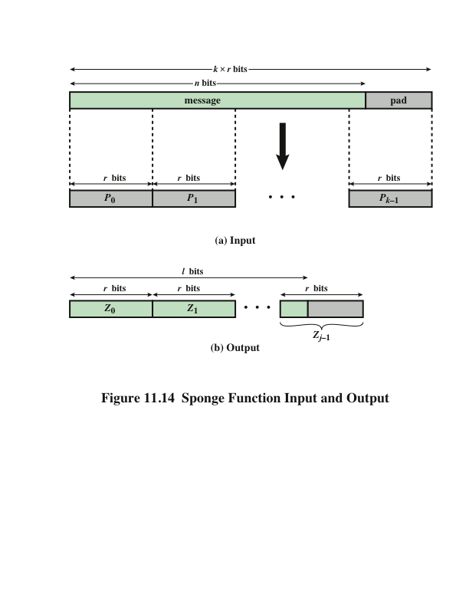
Notes:
A sponge function allows both variable length input and output, making it a
flexible structure that can be used for a hash function (fixed-length output), a pseudorandom
number generator (fixed-length input), and other cryptographic functions.
Figure 11.14 illustrates this point.
The sponge specification proposes [BERT11] proposes
two padding schemes:
• Simple padding: Denoted by pad10*, appends a single bit 1 followed by the
minimum number of bits 0 such that the length of the result is a multiple of the
block length.
• Multirate padding: Denoted by pad10*1, appends a single bit 1 followed by
the minimum number of bits 0 followed by a single bit 1 such that the length of
the result is a multiple of the block length. This is the simplest padding scheme
that allows secure use of the same f with different rates r . FIPS 202
uses multirate padding.

Slide 58
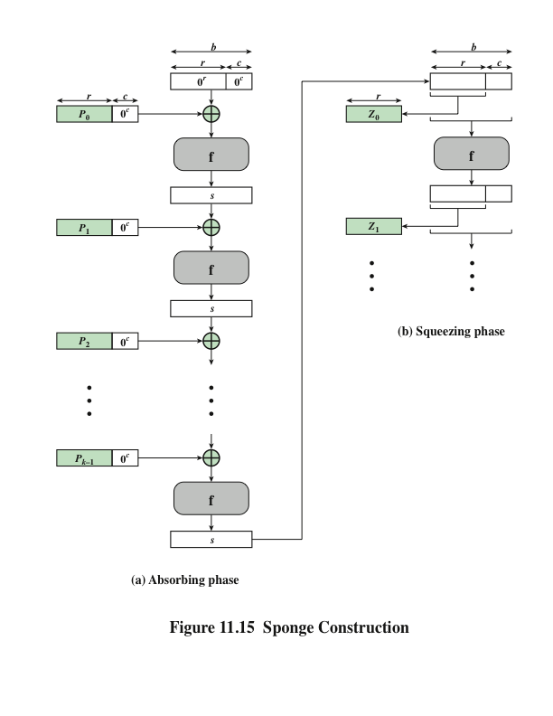
Notes:
Figure 11.15 shows the iterated structure of the sponge function. The sponge
construction operates on a state variable s of b = r + c bits, which is initialized to all
zeros and modified at each iteration. The value r is called the bitrate. This value is
the block size used to partition the input message. The term bitrate reflects the fact
that r is the number of bits processed at each iteration: the larger the value of r, the
greater the rate at which message bits are processed by the sponge construction.
The value c is referred to as the capacity . A discussion of the security implications of
the capacity is beyond our scope. In essence, the capacity is a measure of the achievable
complexity of the sponge construction and therefore the achievable level of
security. A given implementation can trade claimed security for speed by increasing
the capacity c and decreasing the bitrate r accordingly, or vice versa. The default
values for Keccak are c = 1024 bits, r = 576 bits, and therefore b = 1600 bits.

Slide 59
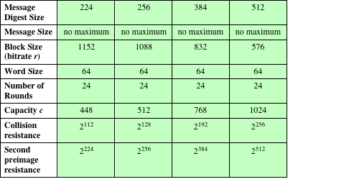
Table 11.5
SHA-3 Parameters
Notes:
Table 11.5 shows
the supported values of r and c. As Table 11.5 shows, the hash function security associated
with the sponge construction is a function of the capacity c .

Slide 60
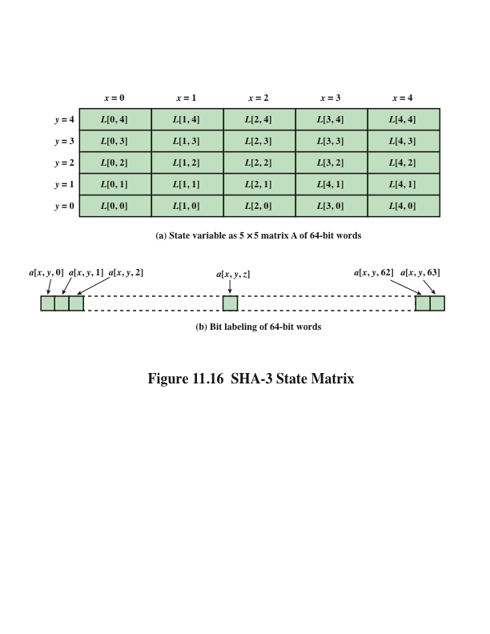
Notes:
We now examine the iteration function Keccak-f used to process each successive
block of the input message. Recall that f takes as input a 1600-bit variable s consisting
of r bits, corresponding to the message block size followed by c bits, referred to as the
capacity. For internal processing within f , the input state variable s is organized as a
5 * 5 * 64 array a. The 64-bit units are referred to as lanes. For our purposes, we generally
use the notation a [x , y , z ] to refer to an individual bit with the state array. When
we are more concerned with operations that affect entire lanes, we designate the
5 * 5 matrix as L [x , y ], where each entry in L is a 64-bit lane. The use of indices
within this matrix is shown in Figure 11.16. Thus, the columns are labeled x = 0
through x = 4, the rows are labeled y = 0 through y = 4, and the individual bits
within a lane are labeled z = 0 through z = 63.
The mapping between the bits of s
and those of a is
s [64(5y + x ) + z ] = a [x , y , z ]
We can visualize this with respect to the matrix in Figure 11.16. When treating
the state as a matrix of lanes, the first lane in the lower left corner, L [0, 0], corresponds
to the first 64 bits of s. The lane in the second column, lowest row, L [1, 0],
corresponds to the next 64 bits of s. Thus, the array a is filled with the bits of s starting
with row y = 0 and proceeding row by row.

Slide 61
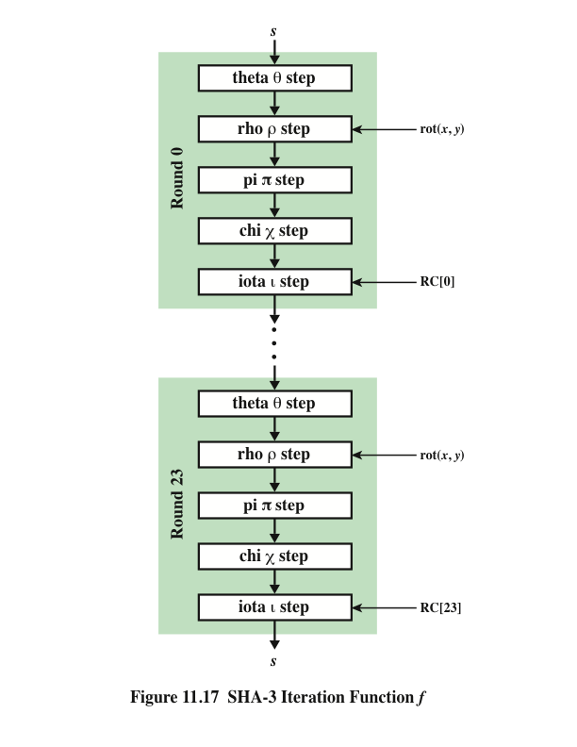
SHA-3 Iteration Function f
Notes:
The function f is executed once for each input block of the message
to be hashed. The function takes as input the 1600-bit state variable and converts
it into a 5 * 5 matrix of 64-bit lanes. This matrix then passes through 24 rounds of
processing. Each round consists of five steps, and each step updates the state matrix
by permutation or substitution operations. As shown in Figure 11.17, the rounds are
identical with the exception of the final step in each round, which is modified by a
round constant that differs for each round.

Slide 62
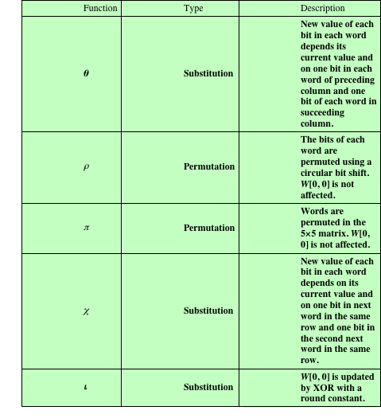
Table 11.6
Step Functions
in SHA-3
Notes:
Table 11.6 summarizes the operation of the five steps. The steps have a simple
description leading to a specification that is compact and in which no trapdoor
can be hidden. The operations on lanes in the specification are limited to bitwise
Boolean operations (XOR, AND, NOT) and rotations. There is no need for table
lookups, arithmetic operations, or data-dependent rotations. Thus, SHA-3 is easily
and efficiently implemented in either hardware or software.

Slide 63
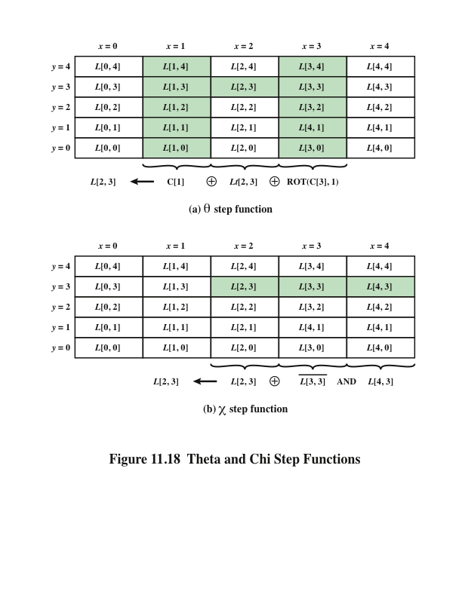
Notes:
Figure 11.18b illustrates the operation of the x function on the bits of the
lane L [3, 2]. This is the only one of the step functions that is a nonlinear mapping.
Without it, the SHA-3 round function would be linear.

Slide 64
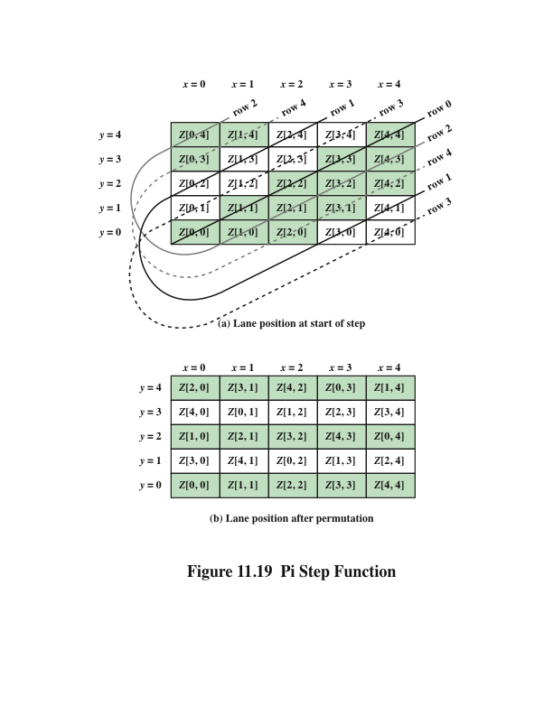
Notes:
Figure 11.19 Pi Step Function

Slide 65
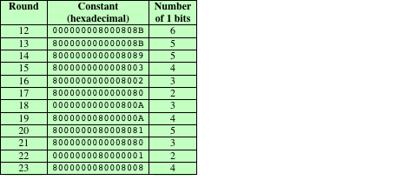
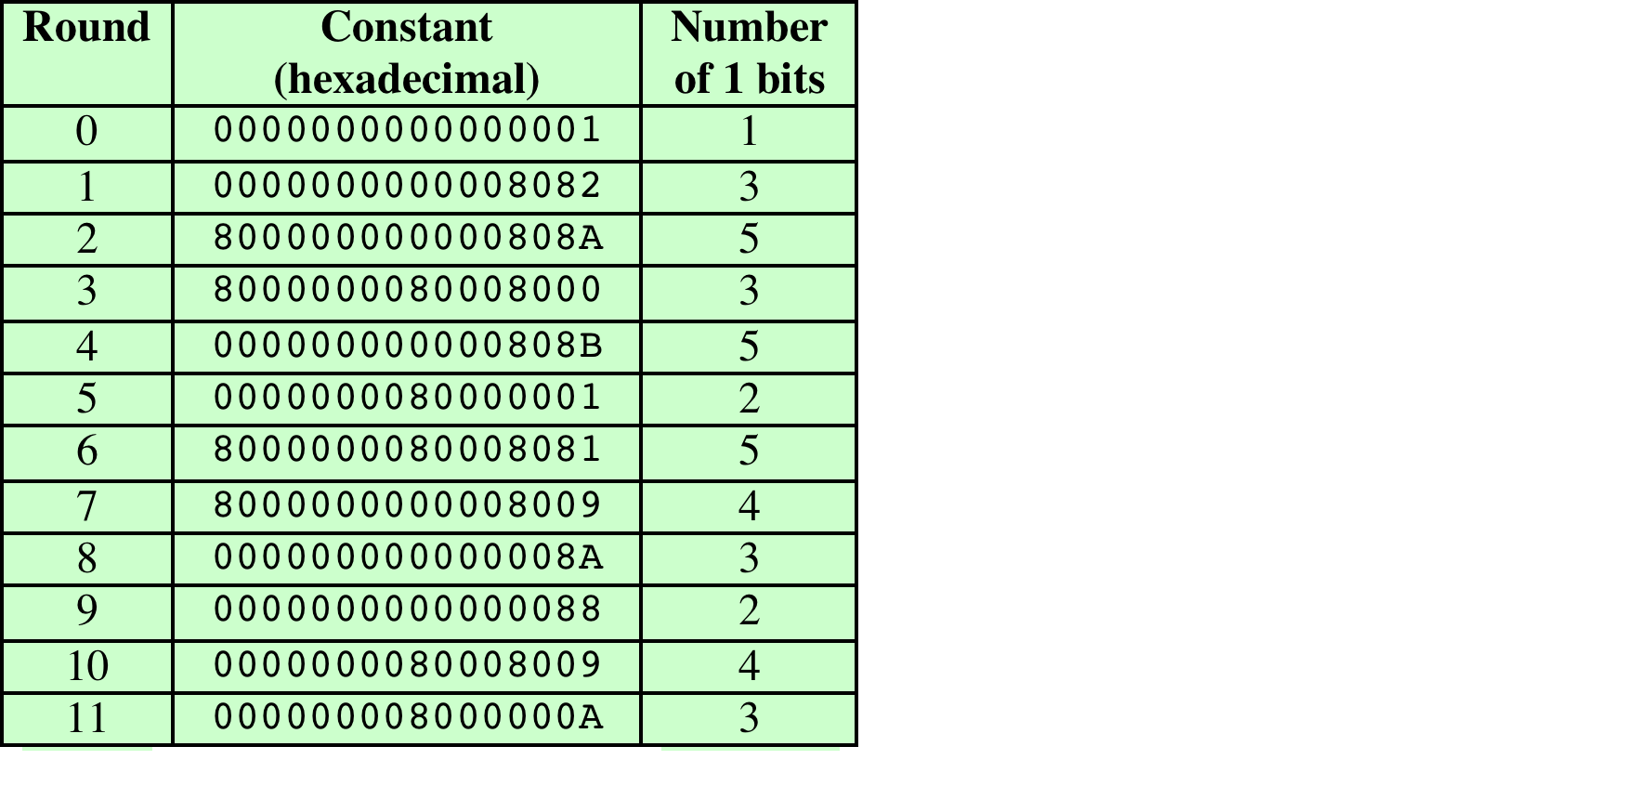
Table 11.8
Round Constants in SHA-3
Notes:
Table 11.8 lists the 24 64-bit round constants. Note that the Hamming weight,
or number of 1 bits, in the round constants ranges from 1 to 6. Most of the bit positions
are zero and thus do not change the corresponding bits in L [0, 0].

Slide 66

Summary
Applications of cryptographic hash functions
Message authentication
Digital signatures
Other applications
Requirements and security
Security requirements for cryptographic hash functions
Brute-force attacks
Cryptanalysis
Hash functions based on cipher block chaining
Secure hash algorithm (SHA)
SHA-512 logic
SHA-512 round function
SHA-3
The sponge construction
The SHA-3 Iteration Function f
Notes:
Chapter 11 summary.

Slide 67
Digital Signature
Operation is similar to that of the MAC
The hash value of a message is encrypted with a user’s private key
Anyone who knows the user’s public key can verify the integrity of the message
An attacker who wishes to alter the message would need to know the user’s private key
Implications of digital signatures go beyond just message authentication
Notes:
Another important application, which is similar to the message authentication
Application, is the digital signature . The operation of the digital signature is similar
to that of the MAC. In the case of the digital signature, the hash value of a message
is encrypted with a user’s private key. Anyone who knows the user’s public key
can verify the integrity of the message that is associated with the digital signature.
In this case, an attacker who wishes to alter the message would need to know the
user’s private key. As we shall see in Chapter 14, the implications of digital signatures
go beyond just message authentication.

Slide 68
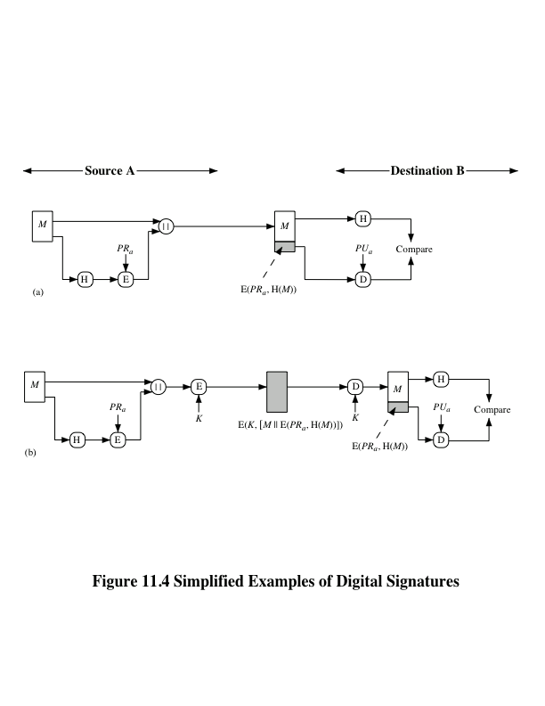

Notes:
Figure 11.4 illustrates, in a simplified fashion, how a hash code is used to provide
a digital signature.
a. The hash code is encrypted, using public-key encryption with the sender’s private
key. As with Figure 11.3b, this provides authentication. It also provides a
digital signature, because only the sender could have produced the encrypted
hash code. In fact, this is the essence of the digital signature technique.
b. If confidentiality as well as a digital signature is desired, then the message
plus the private-key-encrypted hash code can be encrypted using a symmetric
secret key. This is a common technique.

